Slide 1
Capstone: Attribution Learn SQL from scratch
Areeba Abdullah
8/22/2018

Slide 2
Table of Contents
Get familiar with the company
What is the user journey?
Optimize the campaign budget

Slide 3
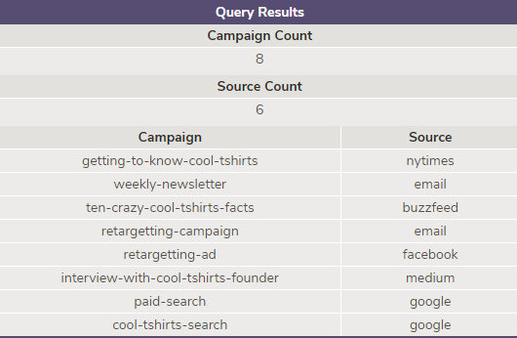
Get familiar with the company
SELECT COUNT (DISTINCT utm_campaign) AS 'Campaign Count'
FROM page_visits;
SELECT COUNT (DISTINCT utm_source) AS 'Source Count'
FROM page_visits;
SELECT DISTINCT utm_campaign AS Campaign, utm_source AS Source
FROM page_visits;
How many campaigns and sources does CoolTShirts use and how are they related?
What is the difference between utm_campaign and utm_source?
CoolTShirts uses 8 campaigns and 6 sources. Campaigns are specific advertisements that are created for specific users while sources are the means by which they are run. A source could run multiple campaigns.
A utm_campaign identifies a specific ad or email blast while a utm_source identifies the site that sent the traffic.

Slide 4
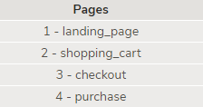
Get familiar with the company
What pages are on their website?
SELECT DISTINCT page_name AS 'Pages'
FROM page_visits;
The 4 distinct pages on their website are landing page, shopping cart, check out and purchase.

Slide 5
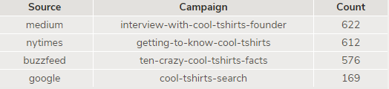
What is the user journey?
How many first touches is each campaign responsible for?
A campaign’s first touch is calculated by finding the minimum timestamp of each user and sorting the result based on the source and campaign. Out of the 8 campaigns, 4 campaigns are responsible for the first touch. The results from the 4 campaigns can be seen below.
WITH first_touch AS (
SELECT user_id,
MIN(timestamp) as first_touch_at
FROM page_visits
GROUP BY user_id),
ft_attr AS ( SELECT ft.user_id,
ft.first_touch_at,
pv.utm_source,
pv.utm_campaign
FROM first_touch ft
JOIN page_visits pv
ON ft.user_id = pv.user_id
AND ft.first_touch_at = pv.timestamp)
SELECT ft_attr.utm_source AS Source, ft_attr.utm_campaign AS Campaign,
COUNT (*) AS Count
FROM ft_attr
GROUP BY Source,Campaign
ORDER BY Count DESC;

Slide 6
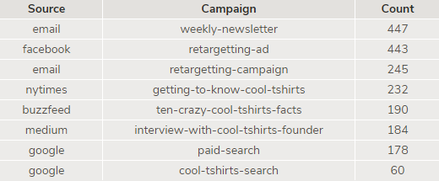
What is the user journey?
How many last touches is each campaign responsible for?
A campaign’s last touch is calculated by finding the maximum timestamp of each user and sorting the result based on the source and campaign. Interesting to note, all 8 campaigns were responsible for last touches and cool t shirts search campaign was in the last slot for both first and last touches. The results of each specific campaign can be seen in the table below.
WITH last_touch AS (
SELECT user_id,
MAX(timestamp) as last_touch_at
FROM page_visits
GROUP BY user_id),
lt_attr AS ( SELECT lt.user_id,
lt.last_touch_at,
pv.utm_source,
pv.utm_campaign
FROM last_touch lt
JOIN page_visits pv
ON lt.user_id = pv.user_id
AND lt.last_touch_at = pv.timestamp)
SELECT lt_attr.utm_source AS Source, lt_attr.utm_campaign AS Campaign,
COUNT (*) AS Count
FROM lt_attr
GROUP BY Source,Campaign
ORDER BY Count DESC;

Slide 7

What is the user journey?
How many visitors make a purchase?
Out of the 1979 users that visited the website, only 361 users made a purchase.
SELECT COUNT (DISTINCT user_id) AS 'Visitor Purchase'
FROM page_visits
WHERE page_name = '4 - purchase' ;

Slide 8
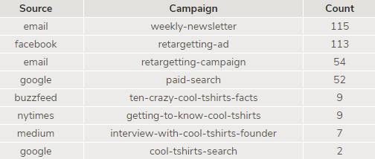
What is the user journey?
How many last touches on the purchase page is each campaign responsible for?
WITH last_touch AS (
SELECT user_id,
MAX(timestamp) as last_touch_at
FROM page_visits
WHERE page_name = '4 - purchase'
GROUP BY user_id),
lt_attr AS ( SELECT lt.user_id,
lt.last_touch_at,
pv.utm_source,
pv.utm_campaign
FROM last_touch lt
JOIN page_visits pv
ON lt.user_id = pv.user_id
AND lt.last_touch_at = pv.timestamp)
SELECT lt_attr.utm_source AS Source, lt_attr.utm_campaign AS Campaign,
COUNT (*) AS Count
FROM lt_attr
GROUP BY Source,Campaign
ORDER BY Count DESC;
The campaigns that users clicked and made a purchase can be seen below. It is interesting to see that the initial traffic generating campaigns are among the lowest when making a purchase.

Slide 9
What is the user journey?
What is the typical user journey?
First Touch
Campaign | Count | Percentage
interview-with-cool-tshirts-founder | 622 | 31%
getting-to-know-cool-tshirts | 612 | 31%
ten-crazy-cool-tshirts-facts | 576 | 29%
cool-tshirts-search | 169 | 9%
First Touches by campaign
Looking at the data, we can see that 91% of users first come to the site through these story campaigns
Interview-with-cool-tshirts-founder
Getting-to-know-cool-tshirts
Ten-crazy-cool-tshirts-facts

Slide 10
What is the typical user journey?
Last Touch
Campaign | Count | Percentage
weekly-newsletter | 447 | 23%
retargetting-ad | 443 | 22%
retargetting-campaign | 245 | 12%
getting-to-know-cool-tshirts | 232 | 12%
ten-crazy-cool-tshirts-facts | 190 | 10%
interview-with-cool-tshirts-facts | 184 | 9%
paid-search | 178 | 9%
cool-tshirts-search | 60 | 3%
Last Touches by campaign
The story campaign that brought initial traffic only accounts for 31% of last touch
34% of the users needed retargeting to redirect them to the website
12% users came from searching
23% users came from looking at newsletters

Slide 11
What is the typical user journey?
Purchases by campaign
Campaign | Count | Percentage
weekly-newsletter | 115 | 31.9%
retargetting-ad | 113 | 31.3%
retargetting-campaign | 54 | 15.0%
paid-search | 52 | 14.4%
ten-crazy-cool-tshirts | 9 | 2.5%
getting-to-know-cool-tshirts | 9 | 2.5%
interview-with-cool-tshirts-founder | 7 | 1.9%
cool-tshirts-search | 2 | 0.6%
Purchases by campaign
Reminders or retargeting campaigns were the most successful in purchasing Tshirts, with 46% users
46.9% users who purchased received newsletters or searched online
The remaining 6.1% users came from story campaigns

Slide 12
Optimize the campaign budget
CoolTShirts can re-invest in 5 campaigns. Which should they pick and why?
If CoolTShirts can reinvest in 5 campaigns, I would suggest to keep the 3 story campaigns as I believe the story campaigns were really successful in bringing the initial traffic to the website
91% of the users first came to the website through these campaigns
The other campaigns would be the retargeting and the weekly-newsletter. These campaigns generate the most purchases with 31.9% users coming from weekly-newsletter and 31.3% coming from retargeting.
Campaign | First Touch Count | First Touch Percentage | Last Touch Count | Last Touch Percentage | Purchase Count | Purchase Percentage
weekly-newsletter | 0 | 0% | 447 | 23% | 115 | 31.9%
retargetting-ad | 0 | 0% | 443 | 22% | 113 | 31.3%
retargetting-campaign | 0 | 0% | 245 | 12% | 54 | 15.0%
paid-search | 0 | 0% | 178 | 9% | 52 | 14.4%
ten-crazy-cool-tshirts | 576 | 29% | 190 | 10% | 9 | 2.5%
getting-to-know-cool-tshirts | 612 | 31% | 232 | 12% | 9 | 2.5%
interview-with-cool-tshirts-founder | 622 | 31% | 184 | 9% | 7 | 1.9%
cool-tshirts-search | 169 | 9% | 60 | 3% | 2 | 0.6%

